Slide 1

Bispectrum and Recurrent Neural Networks :
Improved Classification of Interictal and Preictal States
LEE.YEONSU
2019.11.06

Slide 2

Index
Materials and Method
Bispectral feature extraction
Database
Bispectrum analysis
Higher-order spectral features
Seizure prediction algorithm
Recurrent neural network architecture
LSTM training and data splitting
Classification performance evaluation
Results and Discussion Subject-Specific EEG classification results
Conclusion

Slide 3
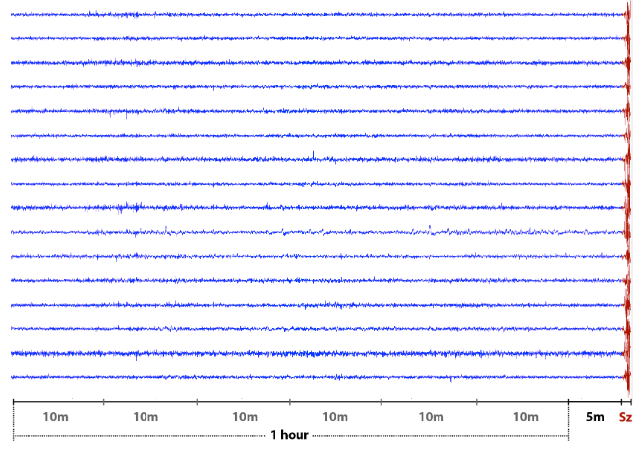
Bispectral feature extraction
Dataset
Canine iEEG (up to 1 year records per dog)
Dog 1 & Dog2 => 17 pre-ictal hours, respectively
Dog3 => 11 pre-ictal hours
Inter ictal = at least 4hours before or after a seizure
Data balance
Num of pre-ictal segments =
Num of inter-ictal segments
Pre-ictal

Slide 4
Bispectral feature extraction
Preprocessing
Subject 1
Subject 2
Subject 3
Subject 4
Subject 5
Subject 6

Slide 5
Bispectral feature extraction
Model
Subject 1
Subject 2
Subject 3
Subject 4
Subject 5
Subject 6

